Slide 1
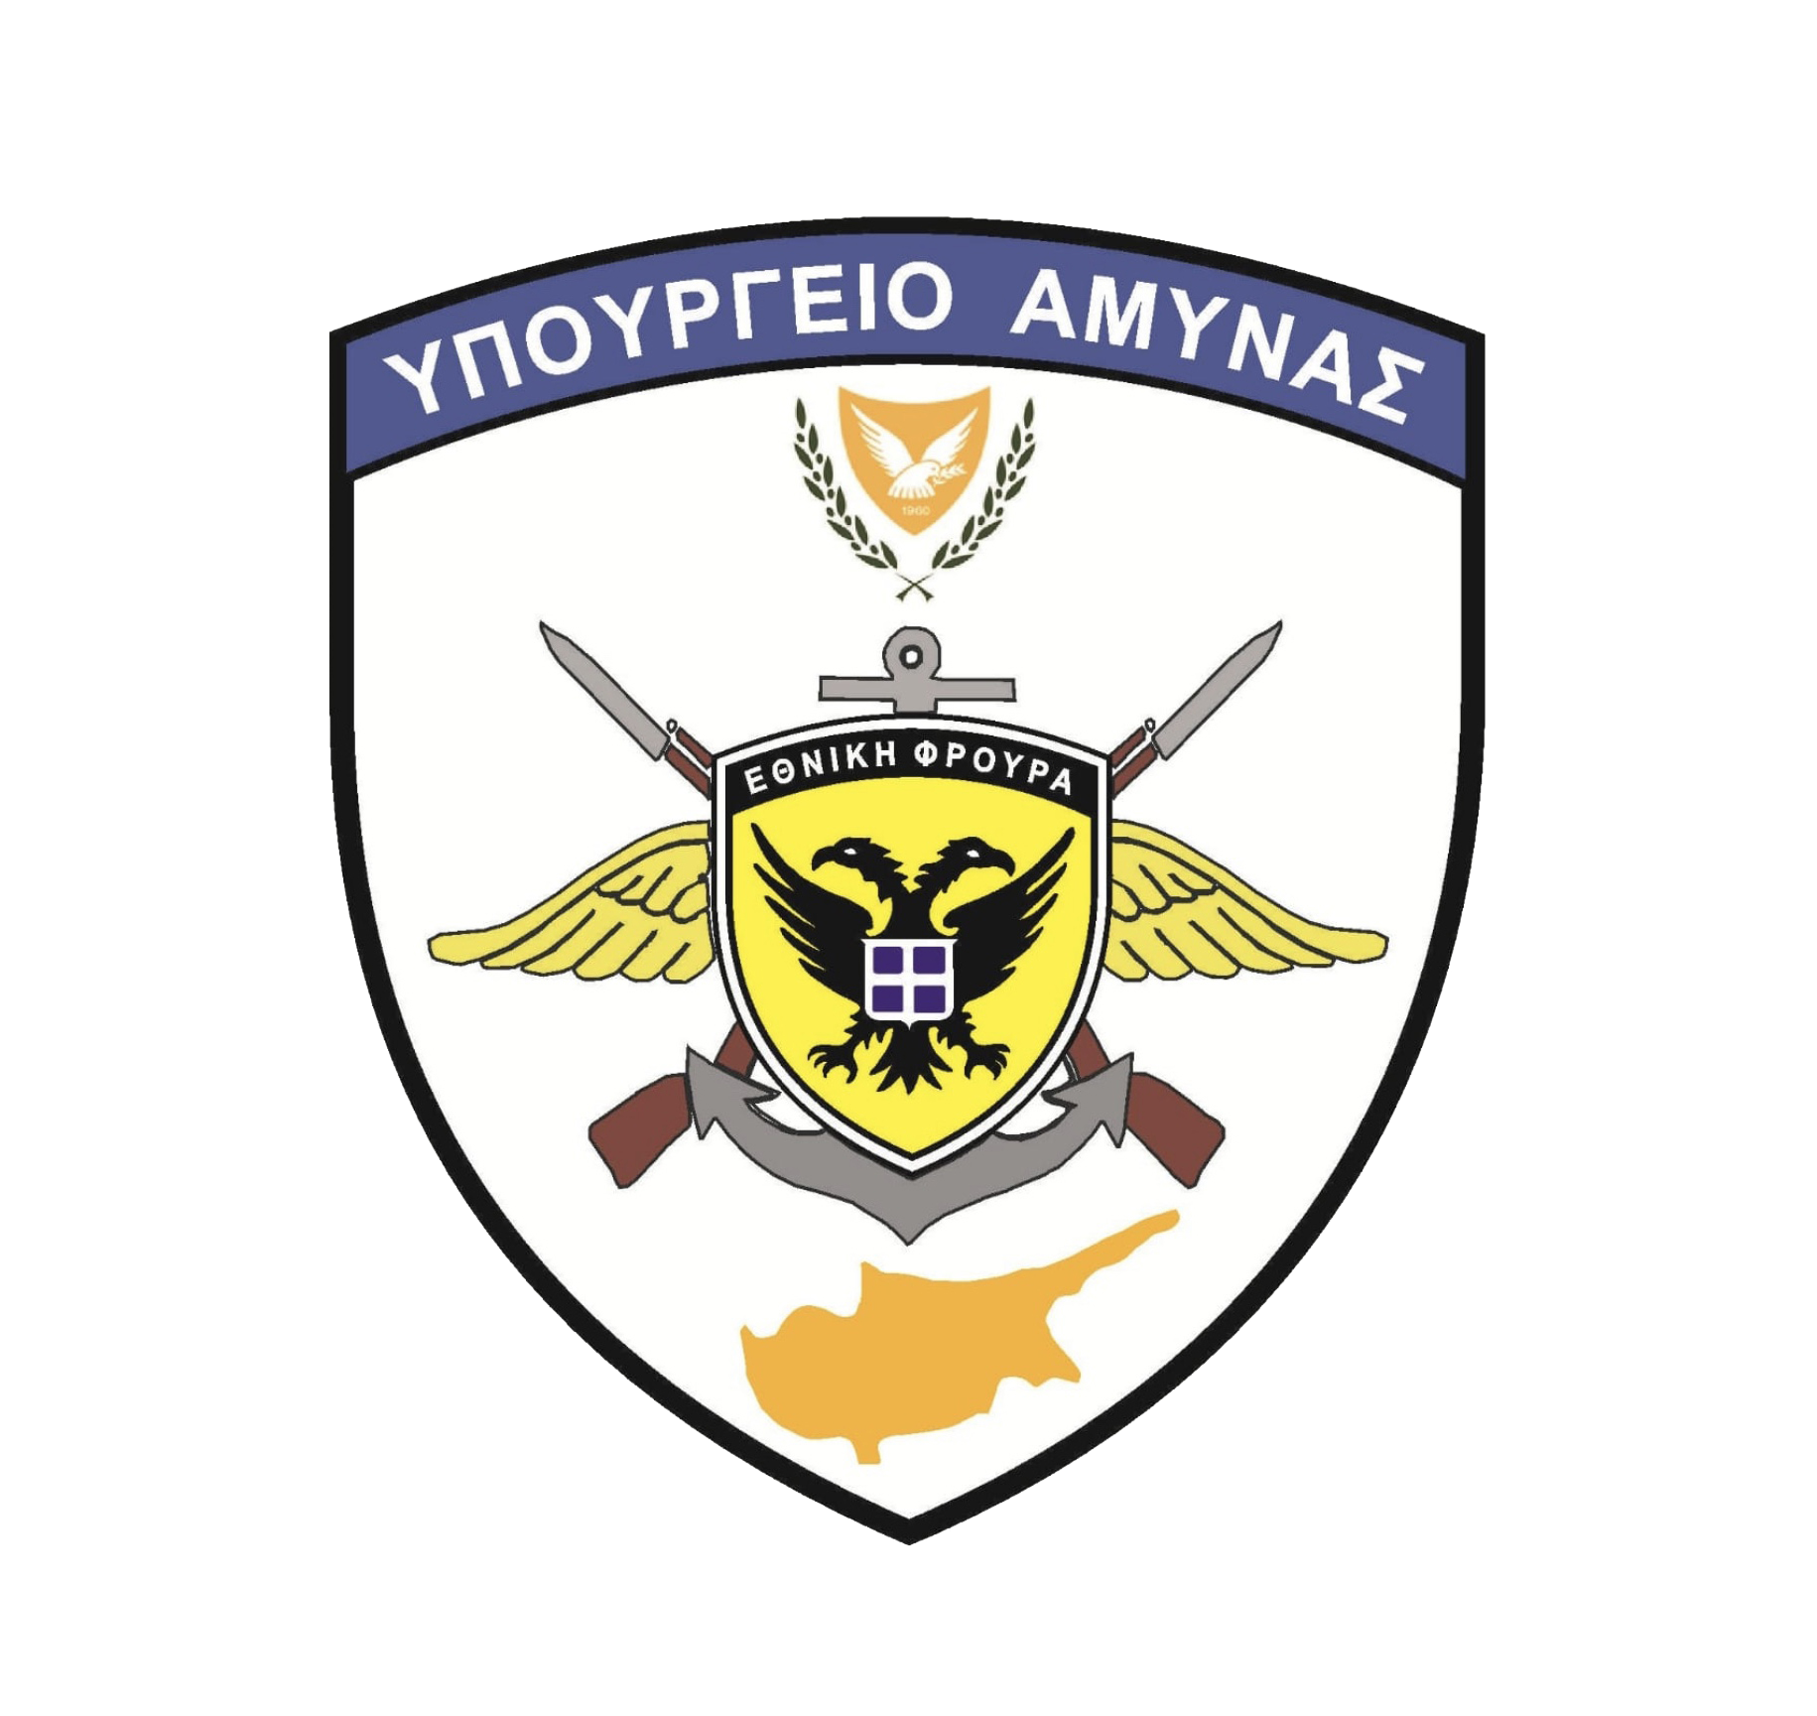
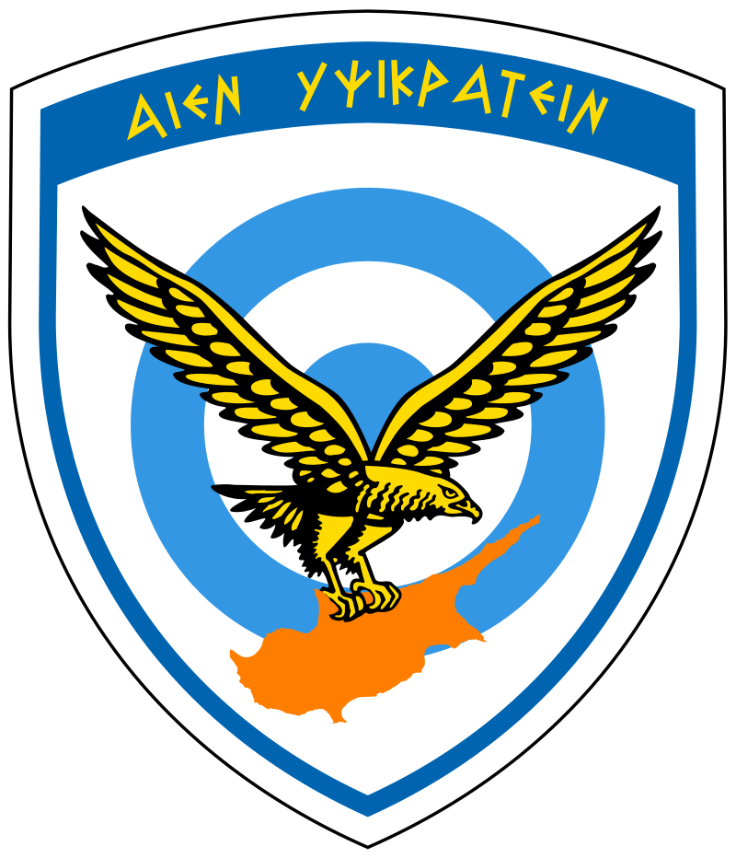
Airforce’s Critical Infrastructure Security Challenges
Supply chain Security
Speaker: Captain (AF) Spyros Evagorou
Avionics-Communications Engineer

Slide 2
Presentation Overview
o The Evolving Threat Landscape
o Air Forces Infrastructure
o Specialized Security Measures
o Vulnerability Spotlight - Supply Chain Security
o Exploiting Supply Chain Weaknesses
o AI and Supply Chain Security
o Building a Resilient Future

Slide 3
The Evolving Threat Landscape
o Rapid advancements in technology
o Malicious use of Artificial Intelligence (AI)
o Increased reliance on interconnected systems
o Evolving cyber threats from:
Nation-States
Hacktivists
Criminal organizations
Nation-State Actor
Hacktivists
Criminal Organizations
Notes:
The landscape of warfare is constantly evolving, driven by rapid advancements in technology. One such advancement is Generative AI, which holds the potential to be one of the major future threats because it is weaponized by malicious actors.
The Air Force relies on a complex network of interconnected systems, and ensuring the security of these systems throughout their lifecycle is paramount to our national security. These systems are constantly under threat from a variety of malicious actors:
Nation-States: These powerful adversaries possess sophisticated capabilities and resources to target critical infrastructure for espionage, disruption, or sabotage.
Hacktivists: These politically motivated actors may target the Air Force to disrupt operations or make a political statement.
Criminal Organizations: These groups may seek to steal sensitive data, extort funds, or disrupt operations for financial gain.
The growing dependence on interconnected systems and the evolving tactics of these malicious actors create a complex and ever-changing threat landscape that we must constantly adapt to.

Slide 4
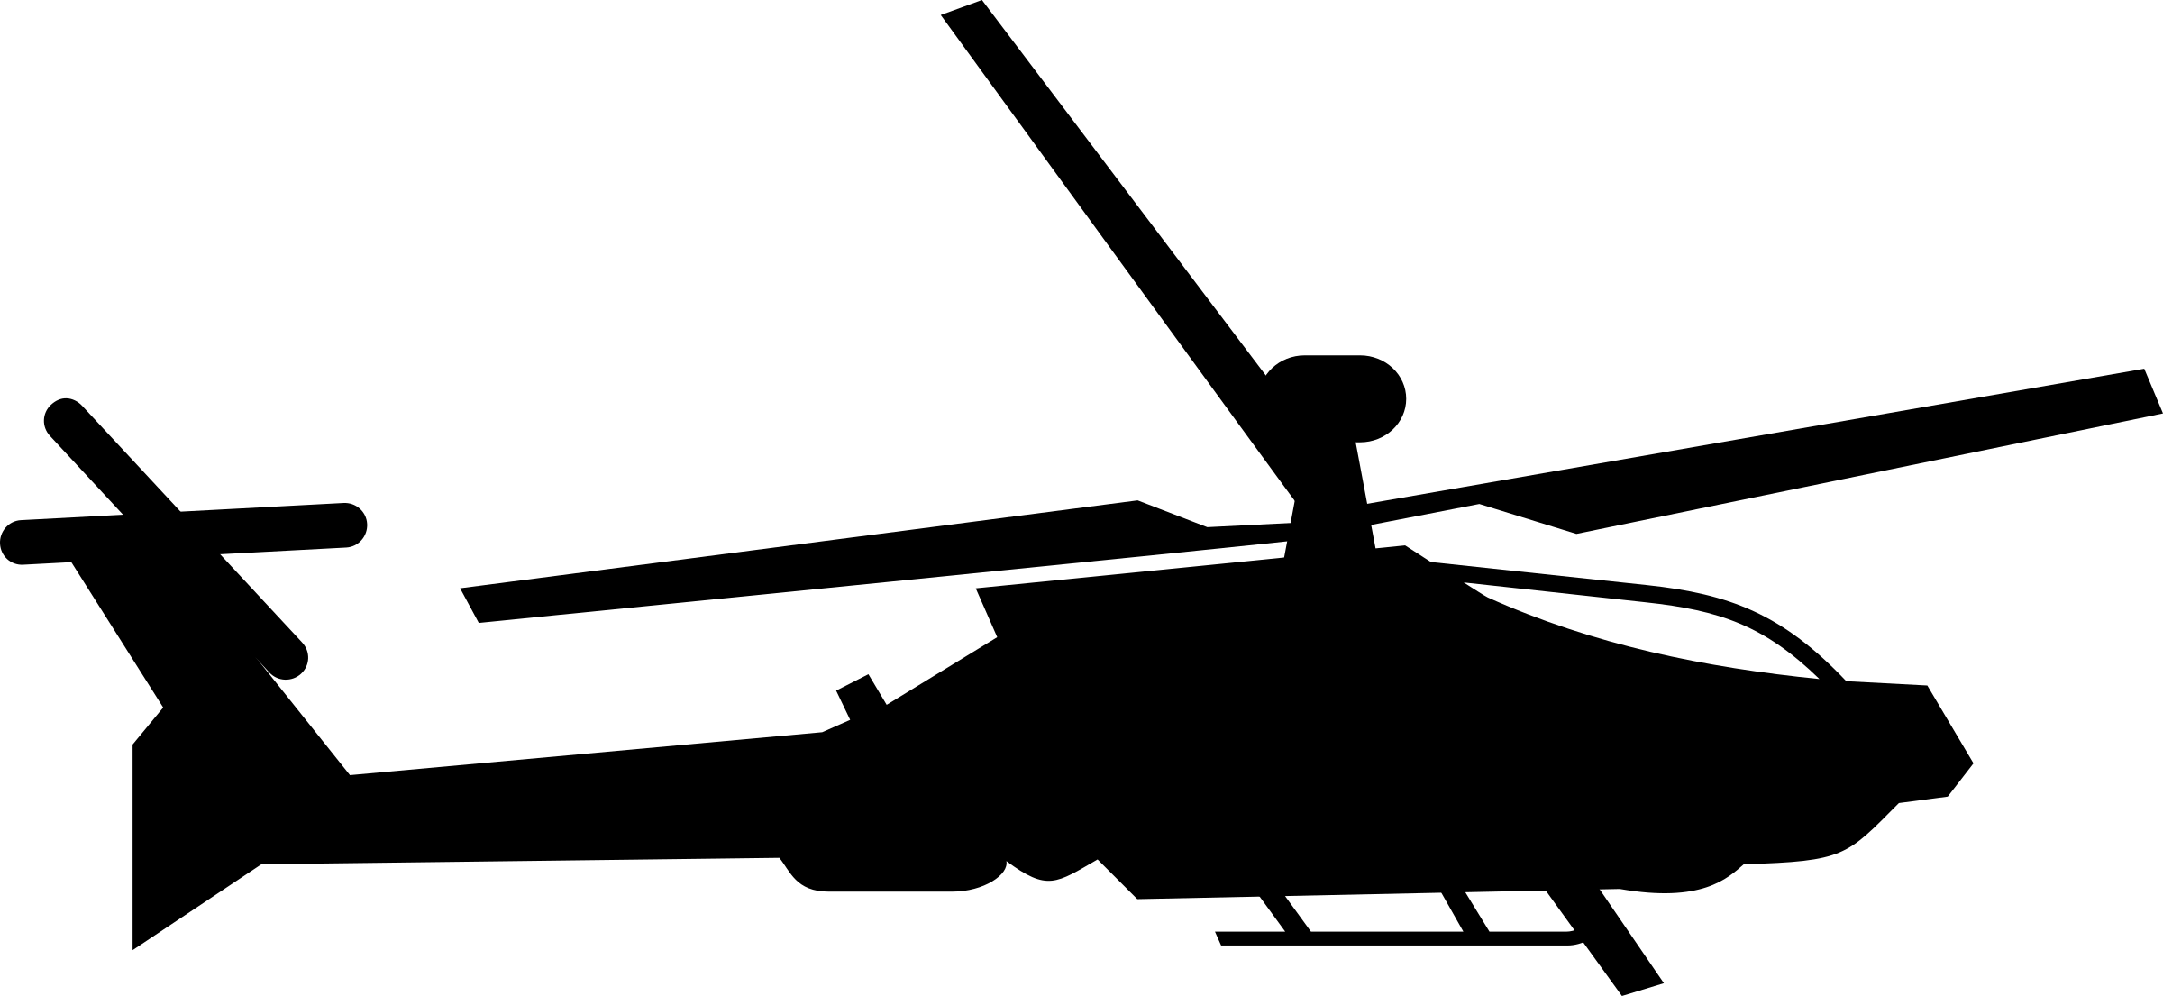
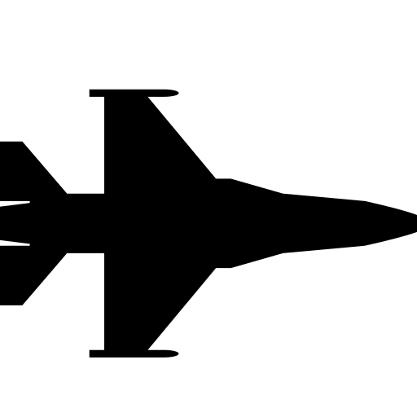
Air Forces Infrastructure
o Communication Networks
o Data Exchange Networks
o Data Storage Facilities - Backups
o Maintenance - Logistics Networks
Notes:
As we saw in the previous slide, the ever-evolving threat landscape makes securing our critical infrastructure a top priority. The Air Force's effectiveness hinges on the optimal, consistent, and reliable operation of these interconnected systems. Let's break down some of the key components that make up this critical infrastructure:
First, we have our Communication Networks. These secure and reliable channels are vital for coordinating missions, ensuring flight safety, and maintaining command and control. Through these networks, real-time communication between aircrews, ground control, and various Air Force units is enabled.
Equally important are our Data Exchange Networks. These networks facilitate the secure exchange of critical information. This information can include radar plots, real-time video, tactical messages, operational plans, threat assessments, and other sensitive data. This secure exchange happens between Air Force units, command centers, intelligence agencies, and allied joint forces.
These vast amounts of sensitive data, in addition to weapons systems operational data, personnel records, and classified documents and correspondence, demand secure storage facilities. These facilities are essential to safeguard national security interests and protect individual privacy.
And lastly, a robust network of suppliers ensures the Air Force has access to the equipment, parts, and personnel required to maintain its operational readiness. This network provides the essential components and expertise needed to keep our aircraft, weapons systems, and other critical infrastructure functioning optimally.
By securing these critical components, we ensure the Air Force can operate effectively and fulfill its mission of defending our nation's airspace.

Slide 5
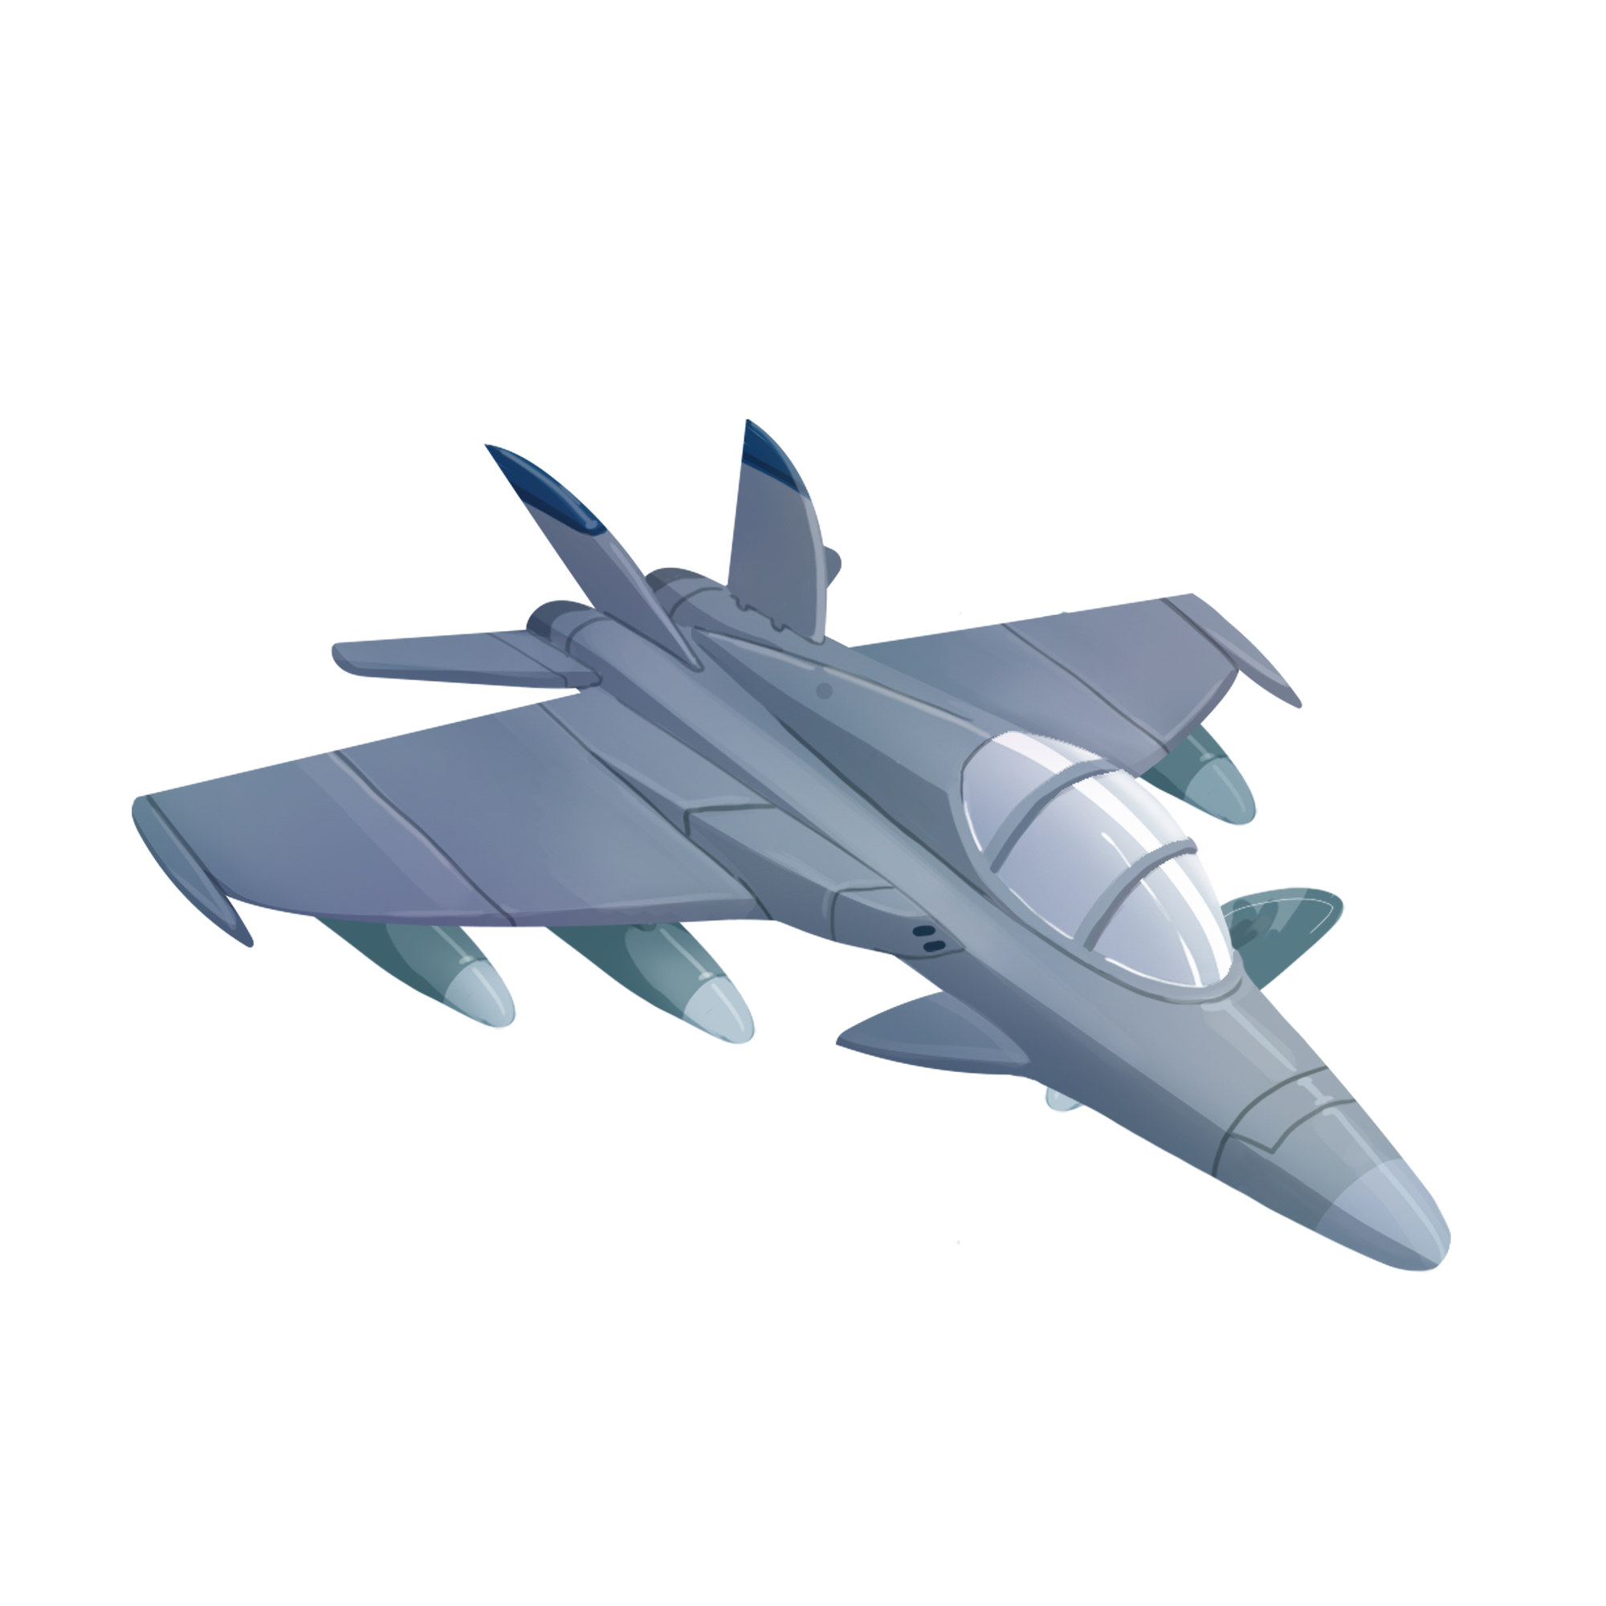
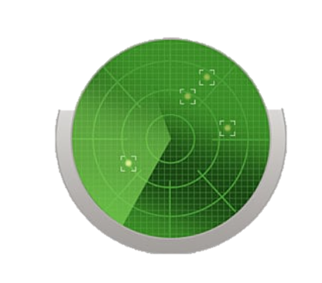
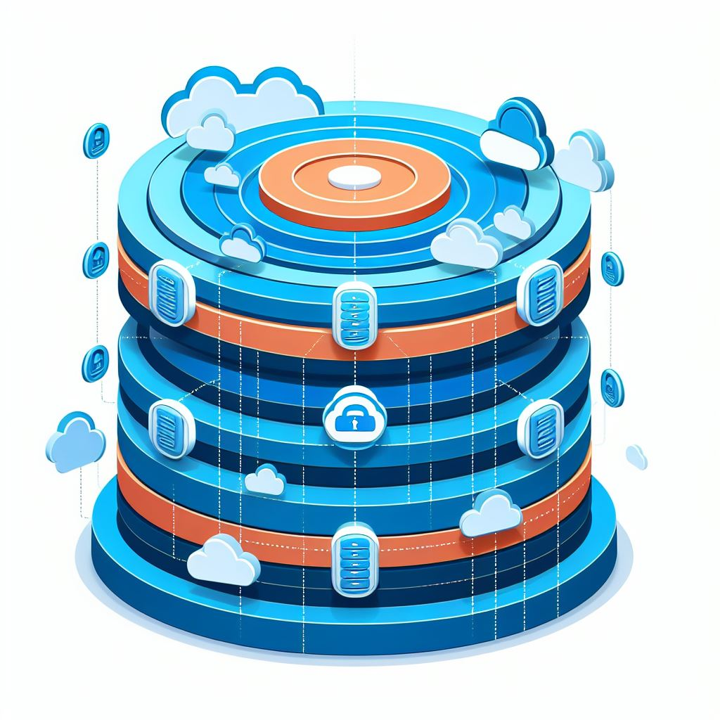
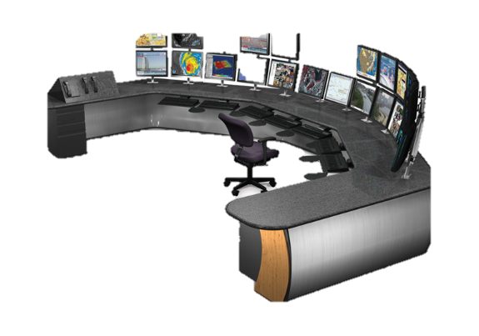
Specialized Security Measures
Specialized Protocols
Robust Cryptography
Rigorous Security Policies
Continuous Testing
Vulnerability Assessments
Notes:
The Air Force takes a multi-layered approach to securing its critical infrastructure.
Our systems are developed with strict detailed military specifications because of each one’s specific mission. To that end, data exchange is implemented through specialized protocols. Only that makes it significantly more difficult for malicious unauthorized access.
Additionally, robust cryptography is implemented end to end through all the network securing sensitive data, rendering it unreadable to any unauthorized party.
Beyond technical safeguards, rigorous security policies are implemented across all systems. These policies outline frequent personnel training, user access controls, data handling procedures, and incident response protocols, ensuring that only authorized personnel have access to sensitive information and that any security breaches are identified, contained, and remediated promptly.
Also, systems periodically undergo testing and vulnerability assessments for weaknesses, and scarce identified vulnerabilities are addressed. This continuous testing helps us stay ahead of evolving threats and maintain a strong security posture.

Slide 6
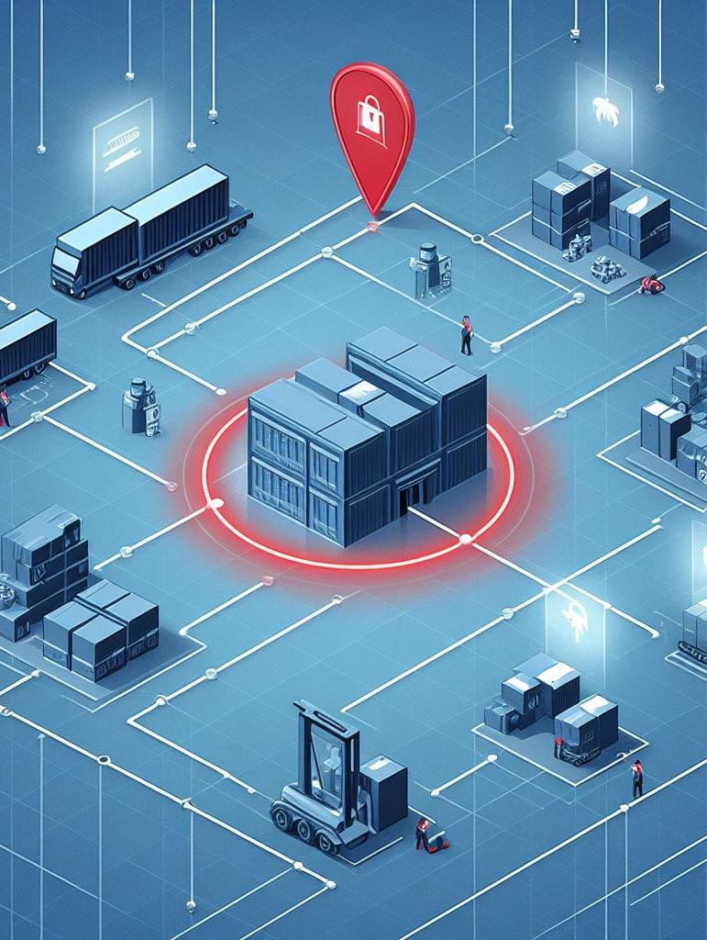
Vulnerability Spotlight Supply Chain Security
o Reliance on External Suppliers
o Potential of Vulnerability Exploitation
o Compromised Suppliers Network
- Infiltration
- Counterfeit Components

Slide 7
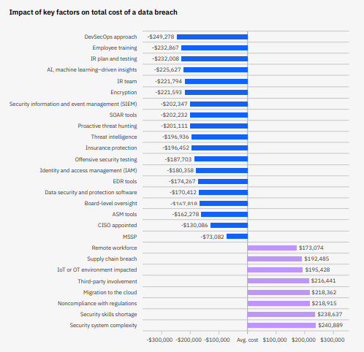
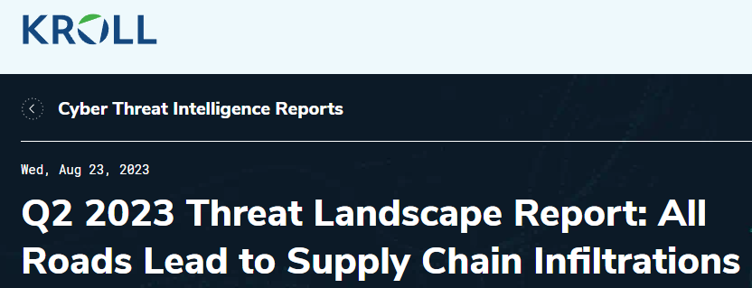
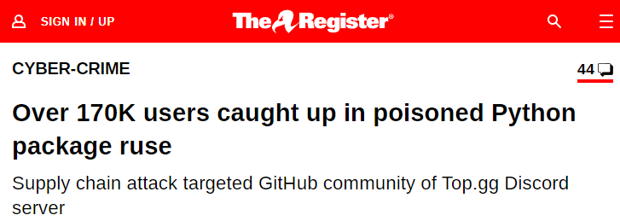
Vulnerability Spotlight Supply Chain Security
$192,485
Supply Chain Breach

Slide 8
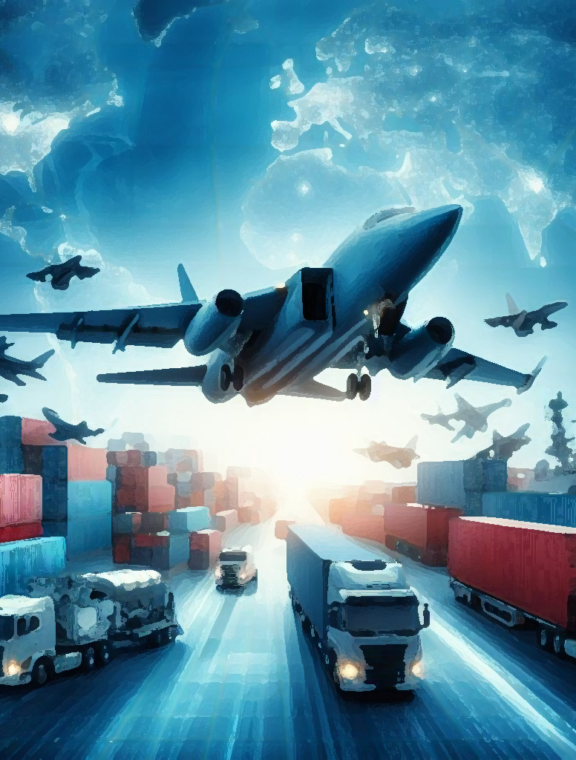
Exploiting Supply Chain Vulnerabilities
o Infiltrating Suppliers:
Malware Implant
Backdoor access to sensitive systems
Sensitive Data Breach
Disruption of Supplies / Operations
o Sabotage Components - Assemblies:
Deviation from specifications
System malfunctions, outages, flight safety compromise

Slide 9
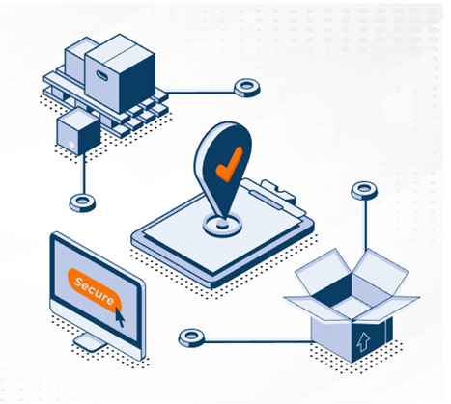
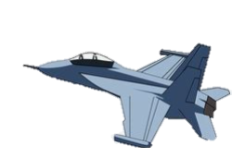
Mitigating Supply Chain Risks
o Supplier Vetting and Risk Assessments
o Collaboration - Information Sharing
o Transparency (Track Components)
Hardware Bill of Materials
Software Bill of Materials (SBOM)
EU’s Cyber Resilience Act (CRA) / US CISA

Slide 10
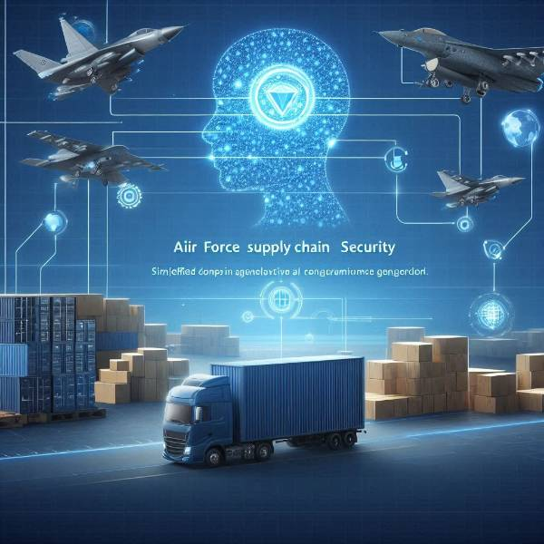
AI and Supply Chain Security
o Detection of Anomalies
o Predictive Analytics - Risk Assessment
o Enhancing Security Protocols
o Integration with threat Intelligence platforms / Update latest threats
Supply Chain Security

Slide 11
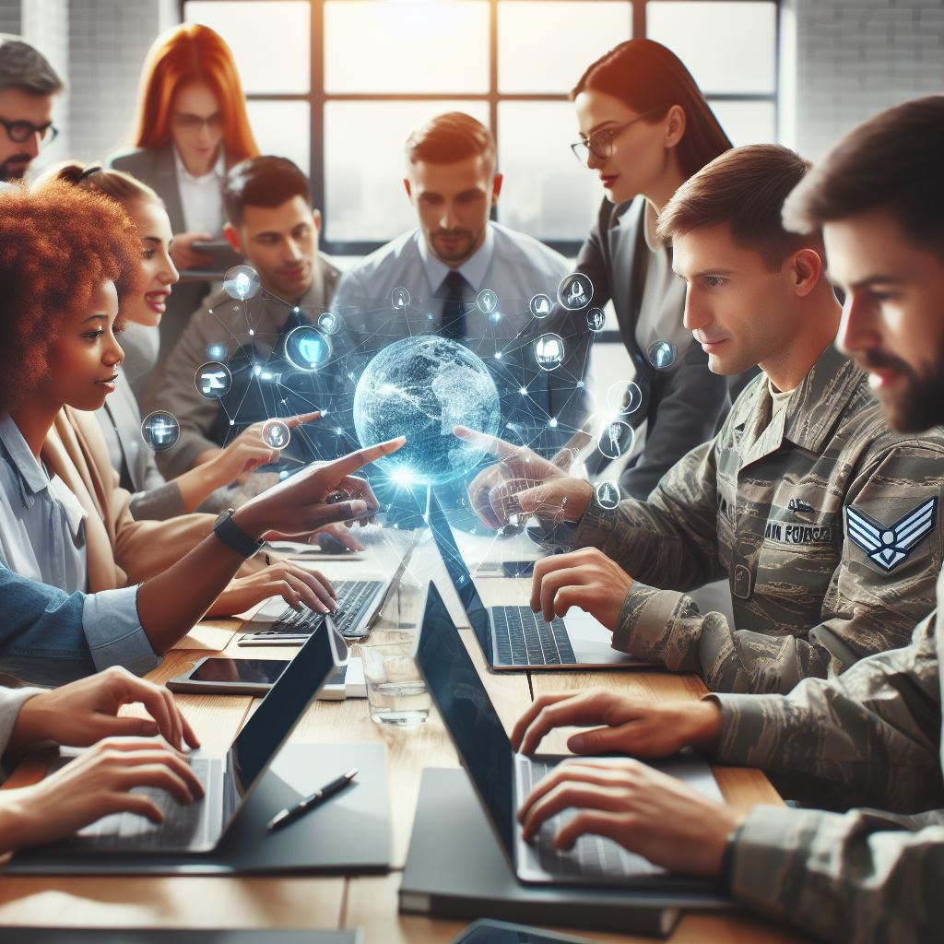
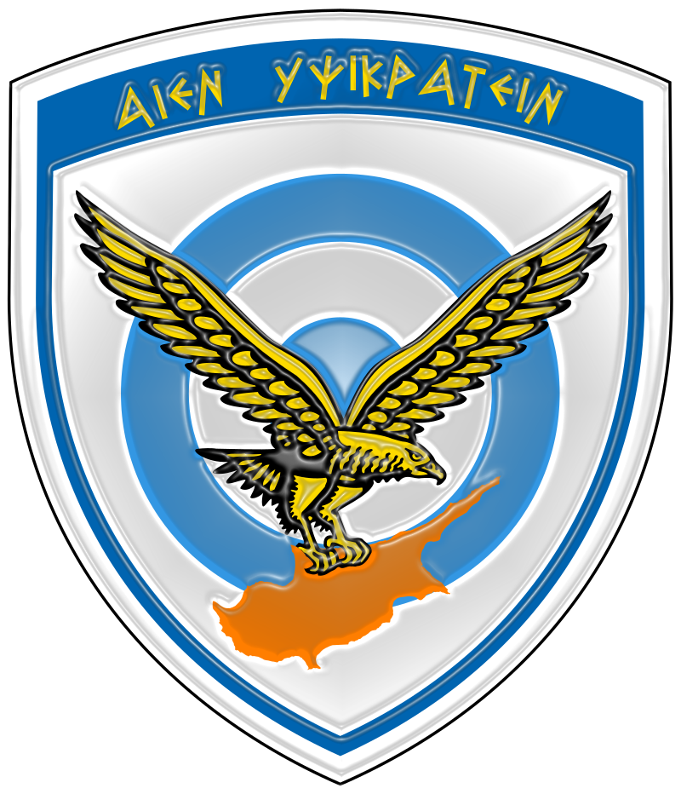
Building a Resilient Future
o Continuous Improvement is Essential
o Importance of Collaboration with Industry Partners
o The Air Force Commitment to Security

